Slide 1
Binary Bandits Presentation
@ZOulhadj
@Nero-DevOps
@archeris32
@@Adam

Slide 2

Our pledge
We vow to act socially responsible and in an honourable manner. All our procedures and activities must abide by all relevant international, national and local laws and contractual terms.

Slide 3
About the project
This group of talented programmers are tasked with creating a data pipeline
demonstrating smooth and efficient implementation.
We will work on the project as a Scrum team and therefore need to
adopt both design methods (user stories) and project management
methods (Agile, Kanban). We will also need to become familiar with the tools
of a typical data pipeline engineers (Python, Git, Docker, Airflow, PostgreSQL, etc.) and
some of the difficult human and technical issues around collaborating on and
continuous improvement of online applications.

Slide 4
TABLE OF CONTENTS
01
02
03
Project Goals
Technologies used
Data Sources and data ingestion
04
05
06
Data processing and storage
Data Pipeline
Results

Slide 5
01
Project Goals

Slide 6
Project Goals
The purpose of the project is to showcase a data pipeline that will analyze sold house prices in UK.
The reason is that the housing market is an important economic indicator and tracking such information is can provide valuable insights about the trend of the housing market, and the economy in general.This pipeline could provide valuable information to people that want to invest in the housing market giving them information about the perfect time to buy.

Slide 7
02
Technologies used

Slide 8

Python
Python is a popular programming language that is commonly used in data pipelines. It can be used for tasks such as data cleaning, data transformation, data analysis and more.
2.Data Analysis
-libraries such as NumPy, SciPy, Scikit-learn can be used for data analysis
3. Integration with other technologies
-can be used to integrate some other technologies into the pipeline such as Airflow, Docker, PostgreSQL
-Python scripts can be executed within Airflow tasks to perform data transformation or analysis.
1.Data Cleaning and transformation
-libraries such as Pandas can be used to manipulate data frames and perform operations like filtering, grouping, joining etc.
-can be used to clean and transform data before storage

Slide 9

PostgreSQL
PostgreSQL is commonly used as data storage and retrieval mechanism in data pipelines.It is a very powerful and reliable relational database management system that can handle large volumes of data.
Steps:
1.Data ingestion
2.Data transformation
3.Data storage
4.Data retrieval

Slide 10

Airflow
Airflow is a open-source platform that can programmatically ,author,schedule and monitor dependent workflows. It uses DAGs to define tasks and their dependencies.In order to use Airflow, several steps needs to be taken:
1.Define DAGs
2.Define tasks
3.Define dependencies
4.Set the schedule interval
5.Execute pipeline
Airflow’s DAG-based approach provides flexible and scalable way to define and execute data pipelines.

Slide 11
03
Data Sources and data ingestion

Slide 12

Data sources
The Land Registry offers open and accessible dataset of sold houses around all of UK. We chose this dataset for quality, accuracy and reliability of data.

Slide 13
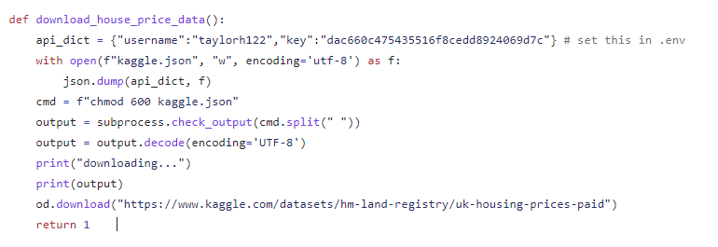
Data ingestion
Is the process of collecting ,preparing and importing the data from HM Land Registry to our pipeline.
The quickes method we found to import the dataset into the pipeline was through Kaggle API, that reads the dataset from the specific location, downloads it so that it can be used within the pipeline.

Slide 14
04
Data processing and storage

Slide 15
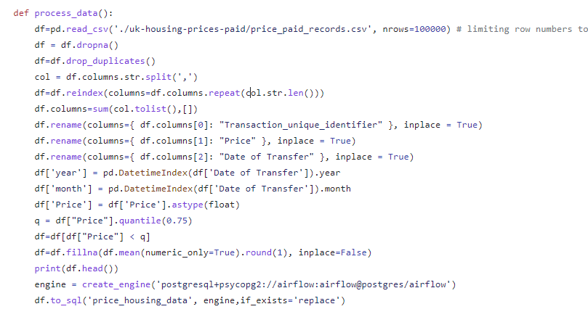
Data processing
Data processing is a critical step in any data pipeline as it involves cleaning,transforming and aggregating data to make it usable for analysis.
Several steps had to be taken in order for the dataset to be useable in our project.
1.Data Cleaning
2.Data Transformation
3.Data Aggregation
4.Create engine for the database
5.Send the data from the dataframe to engine/database

Slide 16
05
Data Pipeline

Slide 17
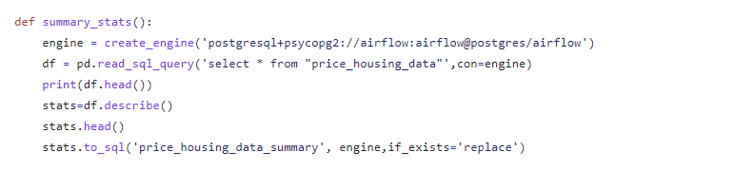
Data analysis
Different tasks were created to show different information from the DB.
The “summary_stats” copies every from the database.

Slide 18
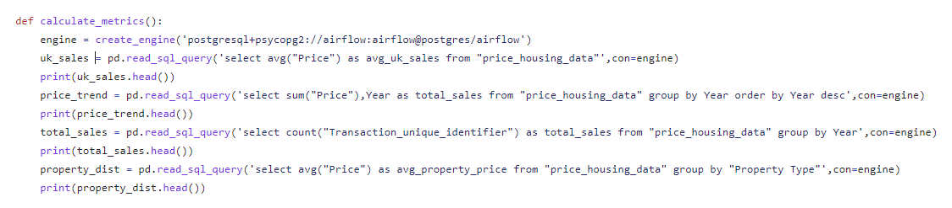
Data analysis
The “calculate_metrics” tasks querries the database for several information such as average price,amount of total sales per year,number of sales per year and average price per type of property.

Slide 19
Data analysis
The “calculate_metrics” tasks querries the database for several information such as average price,amount of total sales per year,number of sales per year and average price per type of property.

Slide 20
Pipeline
.

Slide 21
06
Results

Slide 22
Visualizations

Slide 23
CONCLUSION

Slide 24
Using different technologies presented throughout this module(Python,PostgreSQL,AirFlow,Docker, etc.) , our team managed to create a data pipeline that shows visualizations of the UK’s housing market.
Many lessons were learned during the development such as time management, task allocation, iterative process.Also, developing this project helped us by developing more technical skills, communication and collaboration skills.
.

